Slide 1


J.Sui
01/28/2024

Slide 2

Outline
Executive Summary
Introduction
Methodology
Results
Conclusion
Appendix

Slide 3
Executive Summary
Project Title: Winning the Space Race with Data Science
The objective of this project was to develop a predictive model to identify whether or not the first-stage of a Space X Falcon 9 will land. This model will help inform engineers and other personnel to implement changes that will improve the retention likelihood of the first-stage of the Space X Falcon 9 rocket.
The Space X API was used, that comprised of data from numerous failed and successful launches of the Space X Falcon 9. Numerous data processing techniques and different binary classification models such as logistic regression, SVM, decision trees and KNN to predict the likelihood of first-stage landing.
Logistic Regression, SVM and KNN showed similar performance with an accuracy of 83% across the board.
Recommendations

Slide 4
Introduction
SpaceX offers Falcon 9 rocket launches at a price of $62 million on their website, significantly lower than other providers who charge over $165 million. A key factor in these savings is the reusability of Falcon 9's first stage. Thus, predicting whether the first stage will successfully land is crucial for estimating the launch cost. This data is valuable for competing companies looking to place bids against SpaceX for rocket launches. In this project, we will develop a machine learning pipeline that forecasts the likelihood of the first stage landing successfully, utilizing data gathered from the Space X API.

Slide 5

Section 1

Slide 6
Methodology
Executive Summary
Data collection methodology:
The launch data was collected using Space X’s own API and also through web scraping of the Wikipedia article titled “List of Falcon 9 and Falcon Heavy launches”
Perform data wrangling
In the data set, there are several instances where there are complications. For the first-stage booster “Outcome” column the success of the landing was indicated using more than just True or False, so every success/failure had to be converted into training labels where 1 means the landed successfully and 0 means it was unsuccessful.
Perform exploratory data analysis (EDA) using visualization and SQL
Perform interactive visual analytics using Folium and Plotly Dash
Perform predictive analysis using classification models

Slide 7
Data Collection
We utilized the official SpaceX API and identified the relevant endpoints that provide access to the historical launch data required for our project.

Slide 8
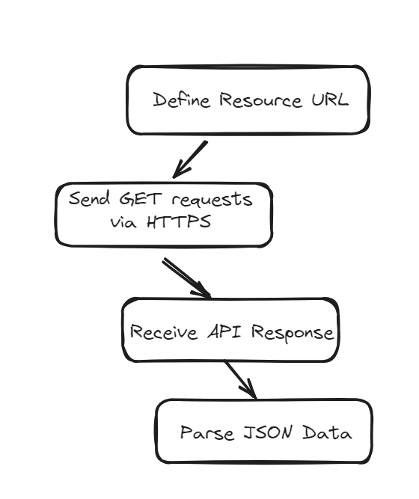
Data Collection – SpaceX API
The API was called using the following steps:
Define Resource URIs
Send GET requests via HTTPS
Receive API Response
If HTTP status code is 200, proceed.
If not, handle the error accordingly.
Parse JSON Data
https://github.com/jimmysway/Coursera-Capstone-SpaceX/blob/main/jupyter-labs-spacex-data-collection-api.ipynb

Slide 9
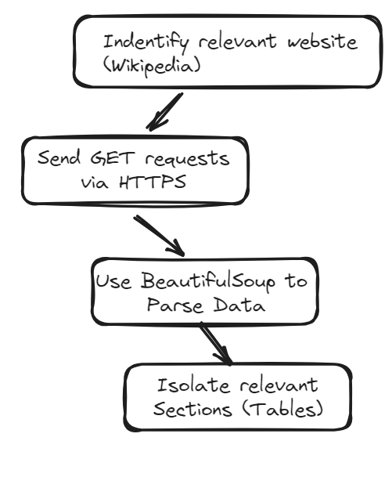
Data Collection - Scraping
The webpage was was called using the following steps:
Website identification (Wikipedia “List of Falcon 9 and Falcon Heavy launches”)
Send HTTP GET requests to retrieve HTML contentAPI Response
If HTTP status code is 200, proceed.
If not, handle the error accordingly.
Use BeautifulSoup to parse and navigate HTML structure
Isolate relevant data sections
https://github.com/jimmysway/Coursera-Capstone-SpaceX/blob/main/jupyter-labs-webscraping.ipynb
Place your flowchart of web scraping here

Slide 10
Data Wrangling
Describe how data were processed
You need to present your data wrangling process using key phrases and flowcharts
Add the GitHub URL of your completed data wrangling related notebooks, as an external reference and peer-review purpose

Slide 11
EDA with Data Visualization
The plots include categorical plots, scatter plots, bar charts, and line charts, each serving a specific purpose in the exploratory data analysis process. These charts explore relationships between various factors such as flight number, payload mass, launch site, orbit type, and the success rate of launches. Through these visualizations, the notebook demonstrates trends and patterns in the data, such as the correlation between increased flight numbers and successful landings, the influence of payload mass on launch outcomes, and the success rates associated with different orbits over time. The selected charts are instrumental in revealing underlying structures in the data and facilitating a deeper understanding of the factors that contribute to successful space missions.
https://github.com/jimmysway/Coursera-Capstone-SpaceX/blob/main/2.Data%20Wrangling%20and%20EDA/jupyter-labs-eda-dataviz.ipynb.jupyterlite.ipynb

Slide 12
EDA with SQL
Using SQL, the following queries were made into the dataset.
Displaying the names of all unique launch sites
Displaying the total payload mass carried by boosters launched by NASA (CRS)
Display average payload mass carried by booster version F9 v1.1
List the names of the boosters which have success in drone ship and have payload mass greater than 4000 but less than 6000
List the total number of successful and failure mission outcomes
List the names of the booster_versions which have carried the maximum payload mass.
List and rank the count of landing outcomes (such as Failure (drone ship) or Success (ground pad)) between the date 2010-06-04 and 2017-03-20
https://github.com/jimmysway/Coursera-Capstone-SpaceX/blob/main/2.Data%20Wrangling%20and%20EDA/jupyter-labs-eda-sql-coursera_sqllite.ipynb

Slide 13
Build an Interactive Map with Folium
To visualize the launch sites on a digital map we used folium and added markers to the map to indicate the launch site, along with marker clusters to indicate the number of launches surrounding the side along with useful lines and indicators that show the distance from the launch sites to the coasts or major cities or railways etc.
https://github.com/jimmysway/Coursera-Capstone-SpaceX/blob/main/2.Data%20Wrangling%20and%20EDA/lab_jupyter_launch_site_location.jupyterlite.ipynb

Slide 14
Build a Dashboard with Plotly Dash
The dashboard incorporates dynamic graphs such as a pie chart to depict launch success rates and a scatter plot that correlates payload mass with launch outcomes. These visualizations are designed to update in response to user interactions, facilitated through controls like dropdowns and sliders.
https://github.com/jimmysway/Coursera-Capstone-SpaceX/tree/main/3.Plotly

Slide 15
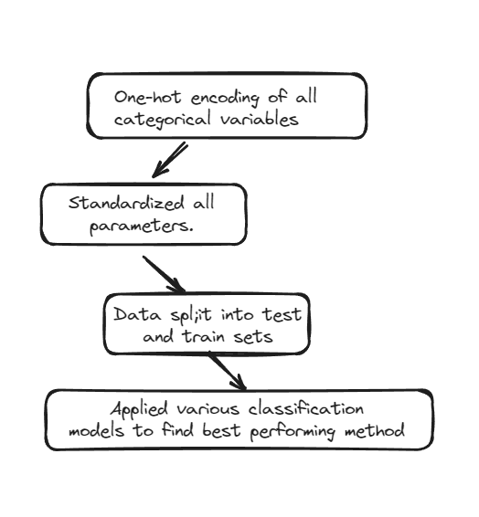
Predictive Analysis (Classification)
To predict the success of first stage landing, we first organized the data, using one-hot encoding, creating columns for all categorical variables. Then the data was standardized and split into training and testing datasets with the test data set being around 20% of the total dataset. Using GridSearchCV we tested various classification models such as SVM, Classification Trees and Logistic Regression to find the best hyperparameters for each.
https://github.com/jimmysway/Coursera-Capstone-SpaceX/blob/main/4.%20Machine%20Learning/SpaceX_Machine_Learning_Prediction_Part_5.jupyterlite.ipynb

Slide 16
Results
Exploratory data analysis results
Interactive analytics demo in screenshots
Predictive analysis results

Slide 17

Section 2

Slide 18
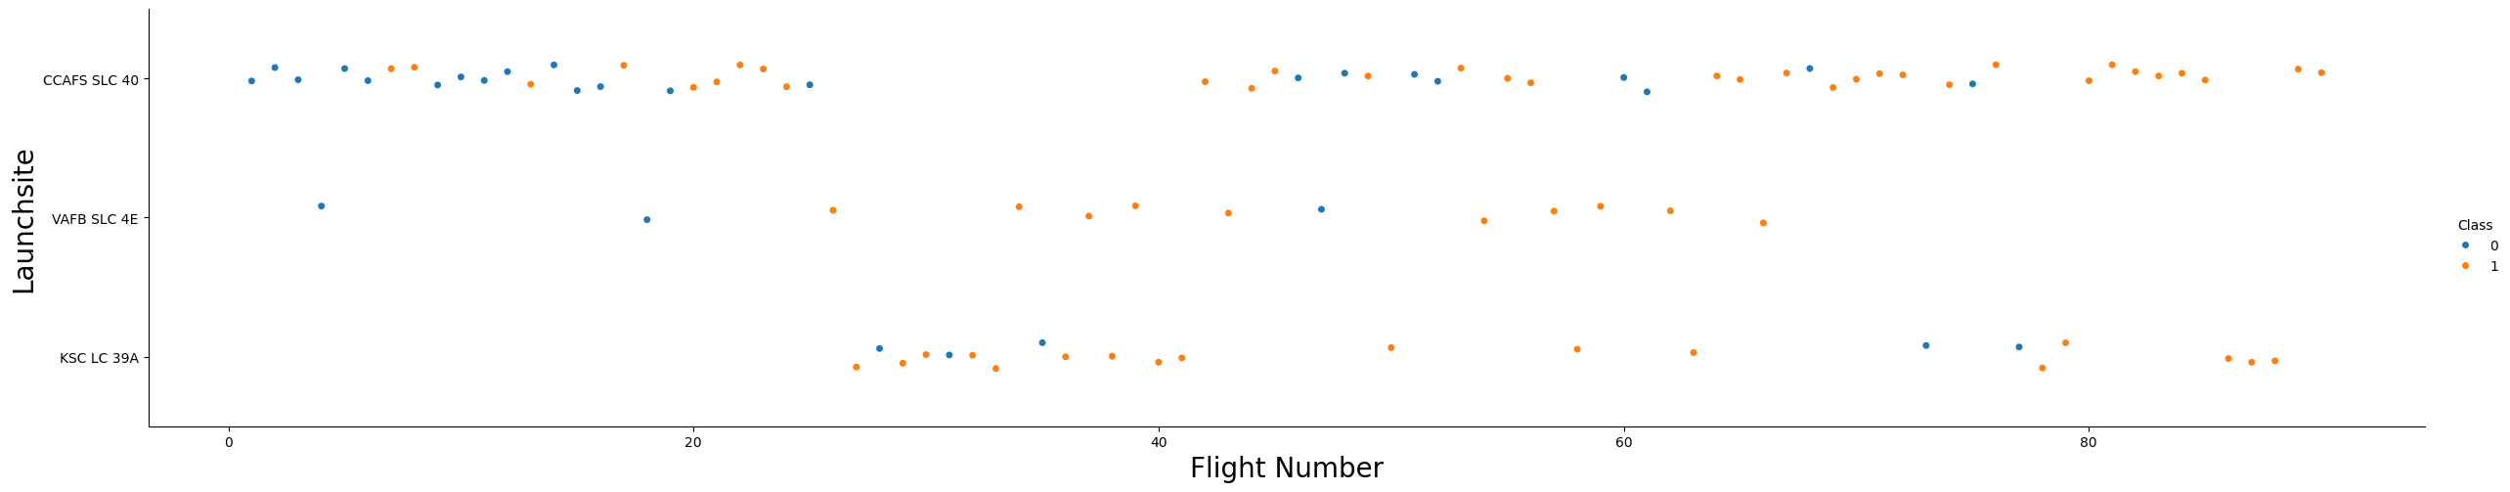
Flight Number vs. Launch Site
Generally speaking as the flight number increases it seems like the number of successes also increase regardless of the launch site

Slide 19
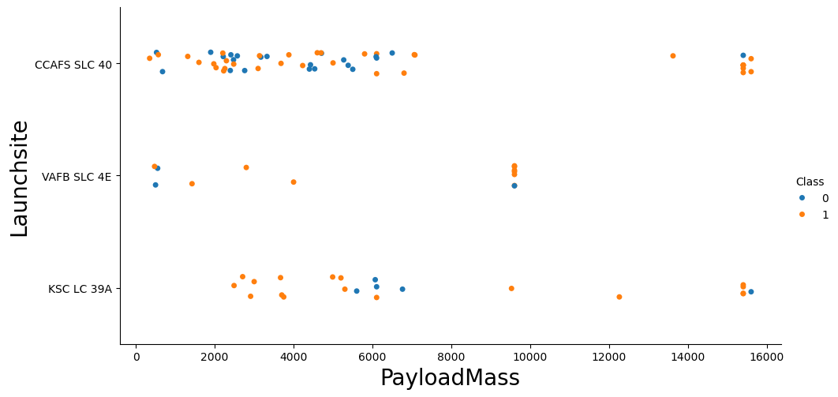
Payload vs. Launch Site
For the VAFB-SLC launch site there are no rockets launched for heavy payload mass (greater than 10000).

Slide 20
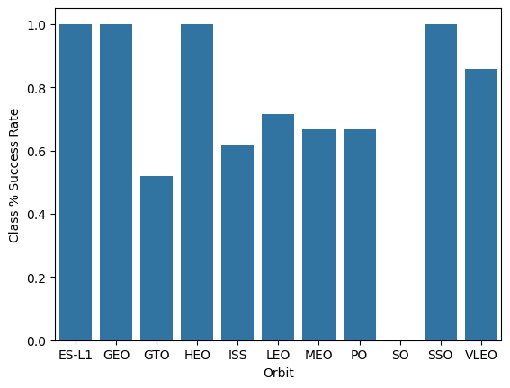
Success Rate vs. Orbit Type
It is obvious that ES-L1, GEO, HEO, SSO have the highest success rate at 100% with GTO (geosynchronous, the one’s that allows satellites to match the Earth’s rotation) orbit having the lowest success rate

Slide 21
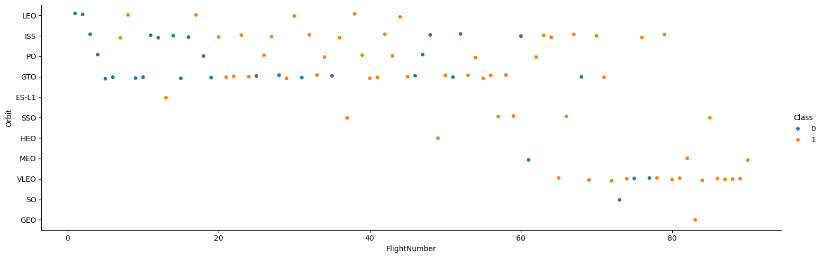
Flight Number vs. Orbit Type
The main missions conducted in the earlier stages involved going into LEO, ISS, PO and GTO where the later missions favoured going in the VLEO, or very-low earth orbit.

Slide 22
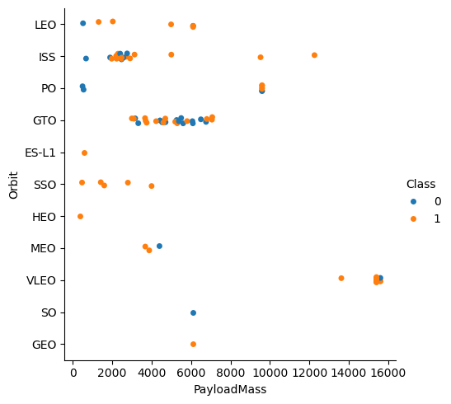
Payload vs. Orbit Type
VLEO orbit allowed for more heavy payloads presumably because the distance from ground is much lower. The other orbits generally don’t exceed 10000kg payload mark.

Slide 23
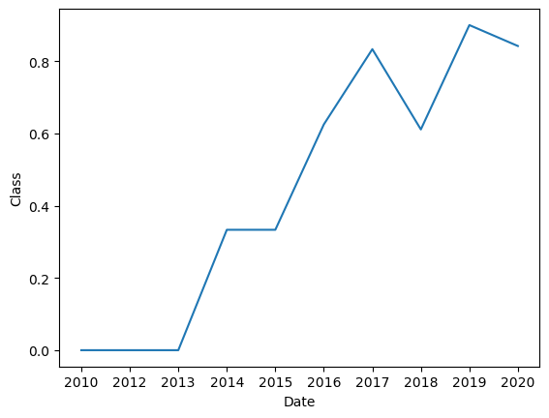
Launch Success Yearly Trend
As more missions were carried out as the years rolled by, the likelihood of success also went up.

Slide 24
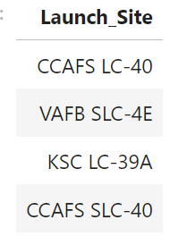
All Launch Site Names
We queried the data to find all the unique launch sites.

Slide 25
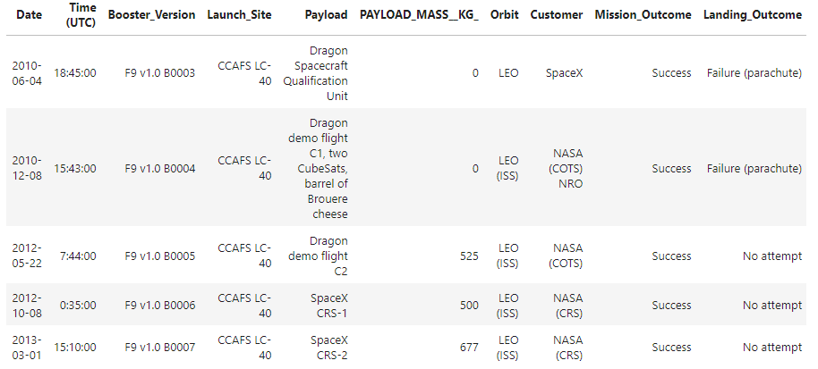
Launch Site Names Begin with 'CCA'

Slide 26

Total Payload Mass
Calculate the total payload carried by boosters from NASA

Slide 27
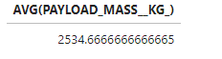
Average Payload Mass by F9 v1.1
Calculate the average payload mass carried by booster version F9 v1.1

Slide 28
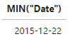
First Successful Ground Landing Date
Find the dates of the first successful landing outcome on ground pad

Slide 29
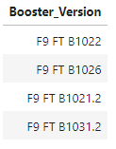
Successful Drone Ship Landing with Payload between 4000 and 6000
List the names of boosters which have successfully landed on drone ship and had payload mass greater than 4000 but less than 6000

Slide 30
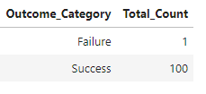
Total Number of Successful and Failure Mission Outcomes

Slide 31
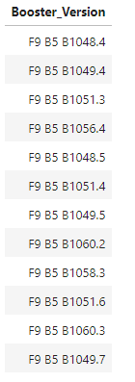
Boosters Carried Maximum Payload
Here are the list of boosters who carried their respective maximum payload

Slide 32
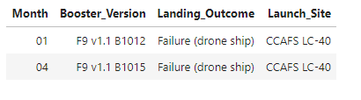
2015 Launch Records
Here we found the 2015 launch records that resulted in a failure when attempting to land on a drone ship.
We can see there are two instances where this occurred in 2015. One in Jan. and the other in April.

Slide 33
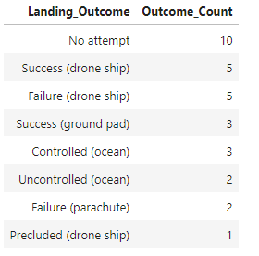
Rank Landing Outcomes Between 2010-06-04 and 2017-03-20
Here we ranked the count of landing outcomes (such as Failure (drone ship) or Success (ground pad)) between the date 2010-06-04 and 2017-03-20, in descending order.
We found that success and failure by method of drone ship were the most frequent and equally likely.

Slide 34

Section 3

Slide 35
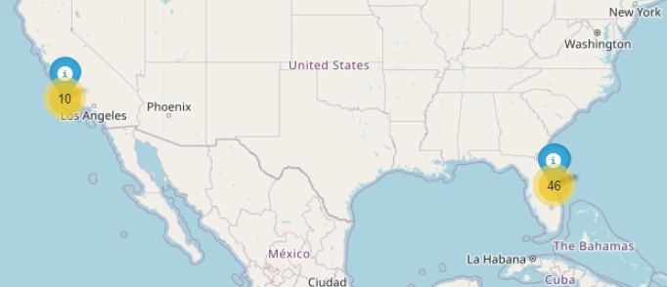
All launch sites of the missions
We see that there are primarily two main geographic locations in which the launches occur one in California and one near Florida with both locations close to the coasts.

Slide 36
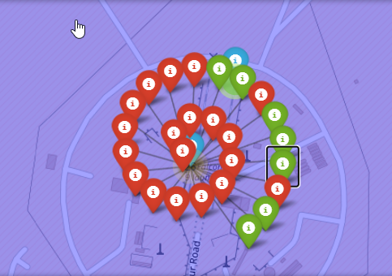
The success/failed launches for each site on the map
The marker clusters depict the success/failure rate upon clicking on a site. Red meaning fail and green meaning success.

Slide 37
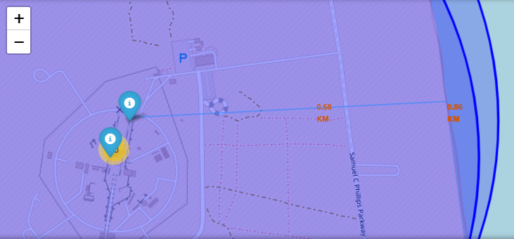
Calculating the distances between a launch site to its proximities
The lines are designed to show a selected launch site to its proximities such as railway, highway, coastline, with distance calculated and displayed.
In this case the distance to the coast.

Slide 38

Section 4

Slide 39
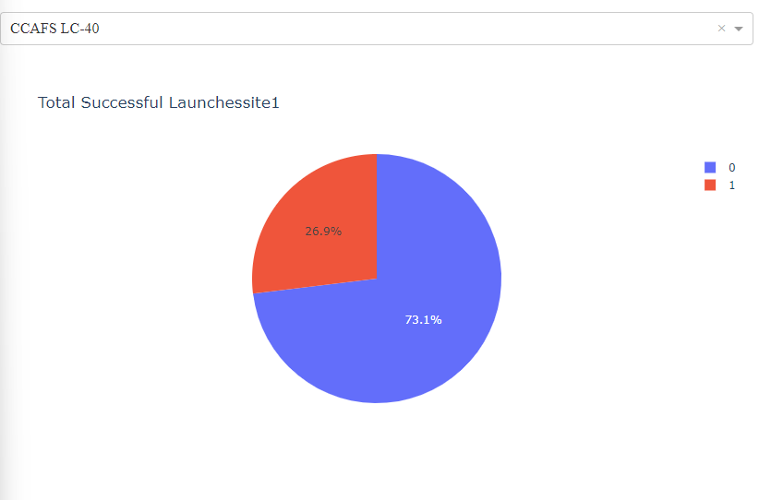
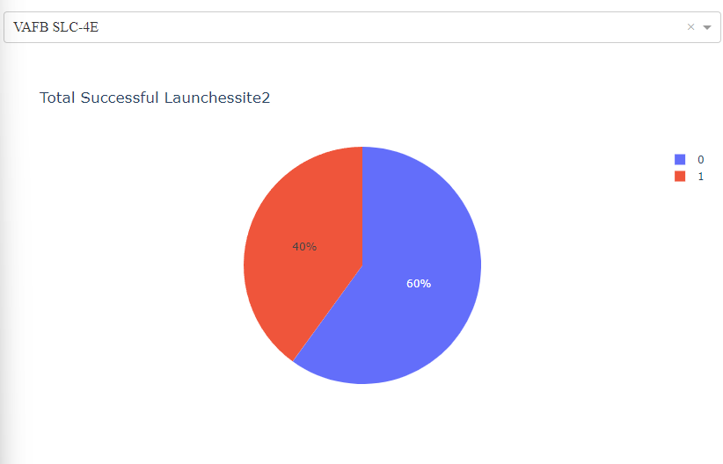
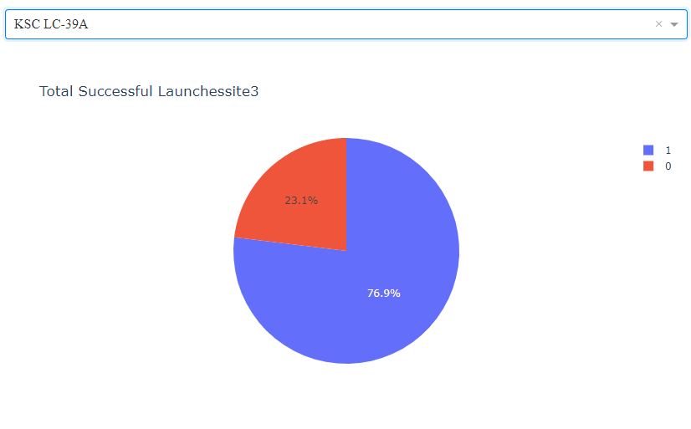
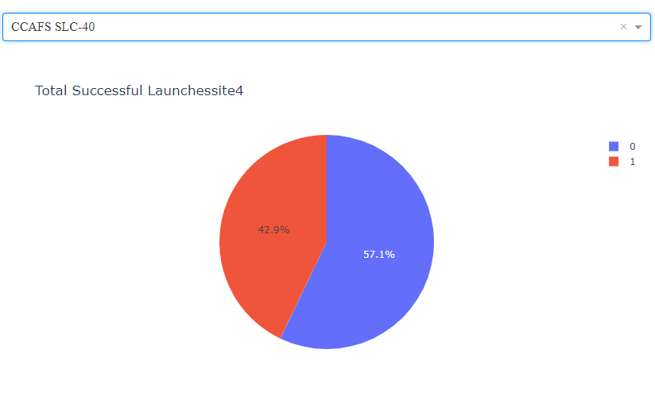
Total percentage of successful launches based on launch site

Slide 40
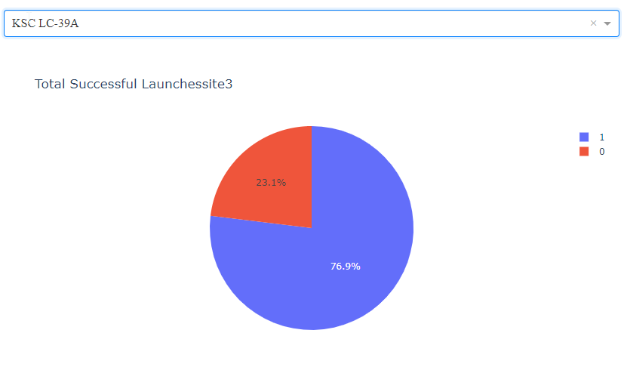
Launch site with highest success ratio
For this data set the launches that were conducted at Kennedy Space Center Launch Complex 39A had a 76.9% success rate.

Slide 41
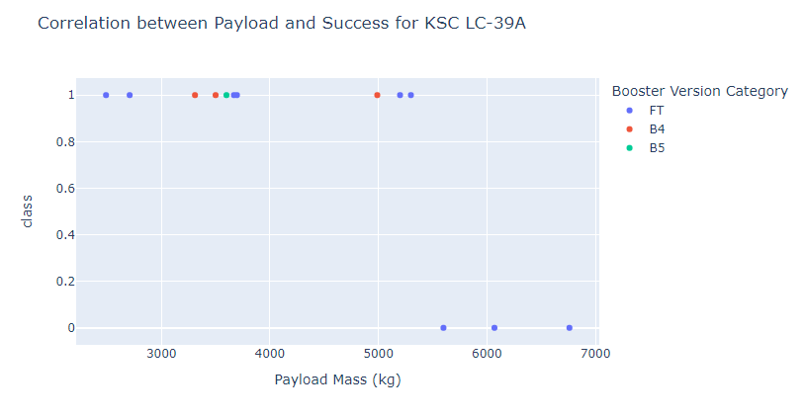
Correlation between Payload Mass and Success for KSC LC-39A
You can see that generally speaking that heavier payloads cause missions to fail with the cutoff here being around 5600kg.
It is also worth noting that the FT boosters were both used for lighter and heavier payloads.

Slide 42

Section 5

Slide 43
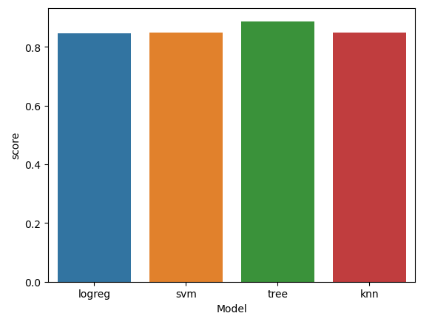
Classification Accuracy
The best model was the decision tree with the following params.

Slide 44
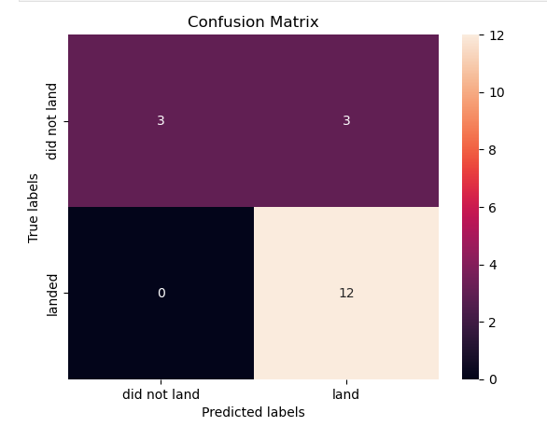
Confusion Matrix – Decision Tree
The confusion matrix for the tree is as follows:
With a test accuracy of 83.3%
The major issue is that the classification model struggles with false positives leading to 3 occasions out of 18 total occasions where it predicted a successful land rather than an unsuccessful one.

Slide 45
Conclusions
The greater number of flights at a particular launch site greatly increases the odds of success
Success rate increased as the total number of flights increased
Likely that heavier payloads may compromise success.
KSC LC-39A had the most proportion of successful launches out of any launch site
The decision tree model was the best machine learning algorithm for this task

Slide 46
Appendix
All the resources used for the project can be found below.
https://github.com/jimmysway/Coursera-Capstone-SpaceX

Slide 47


